Slide 1
Kozepiskolasok - legyetek programozok
Miskolczi Zsolt - Staff Software Engineer

Slide 2
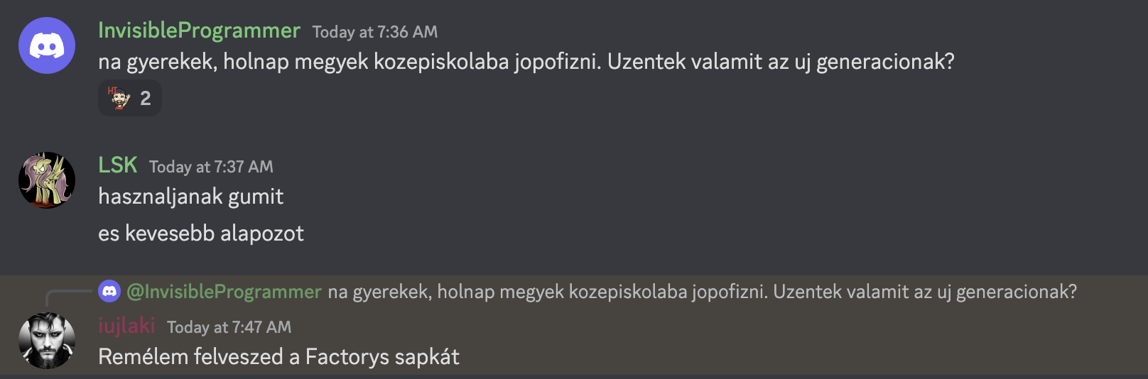

Slide 3
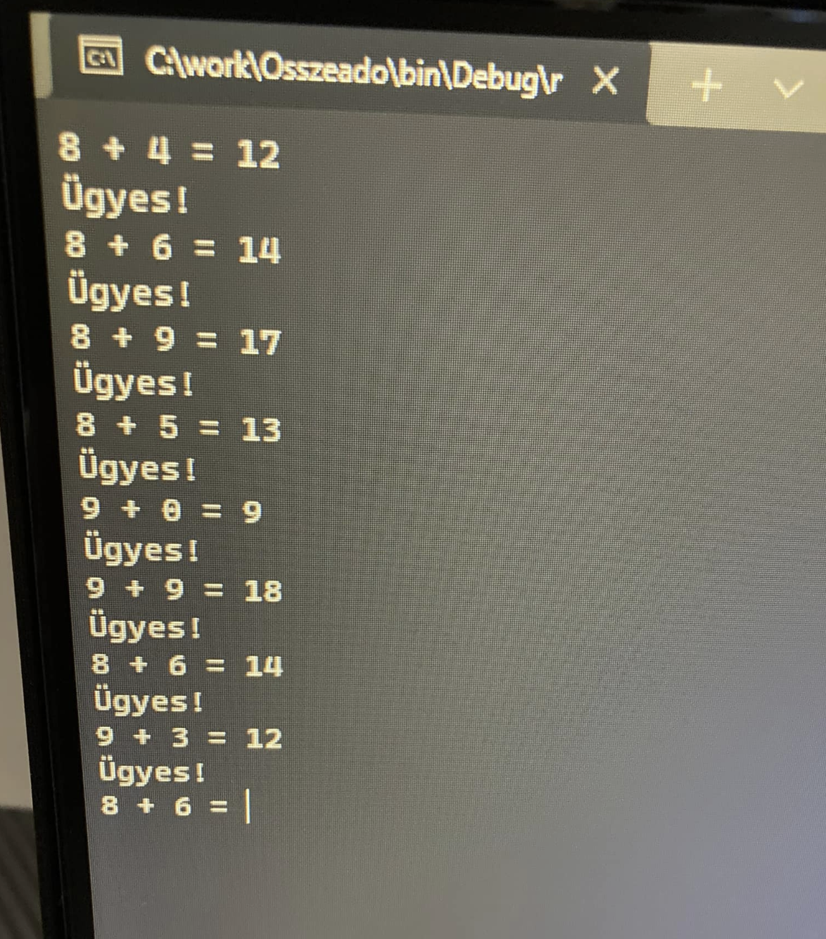
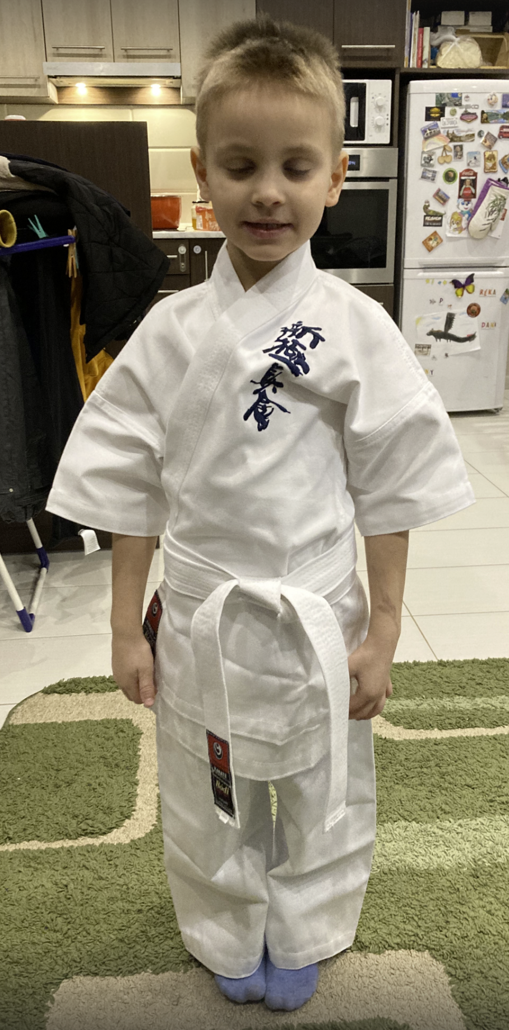
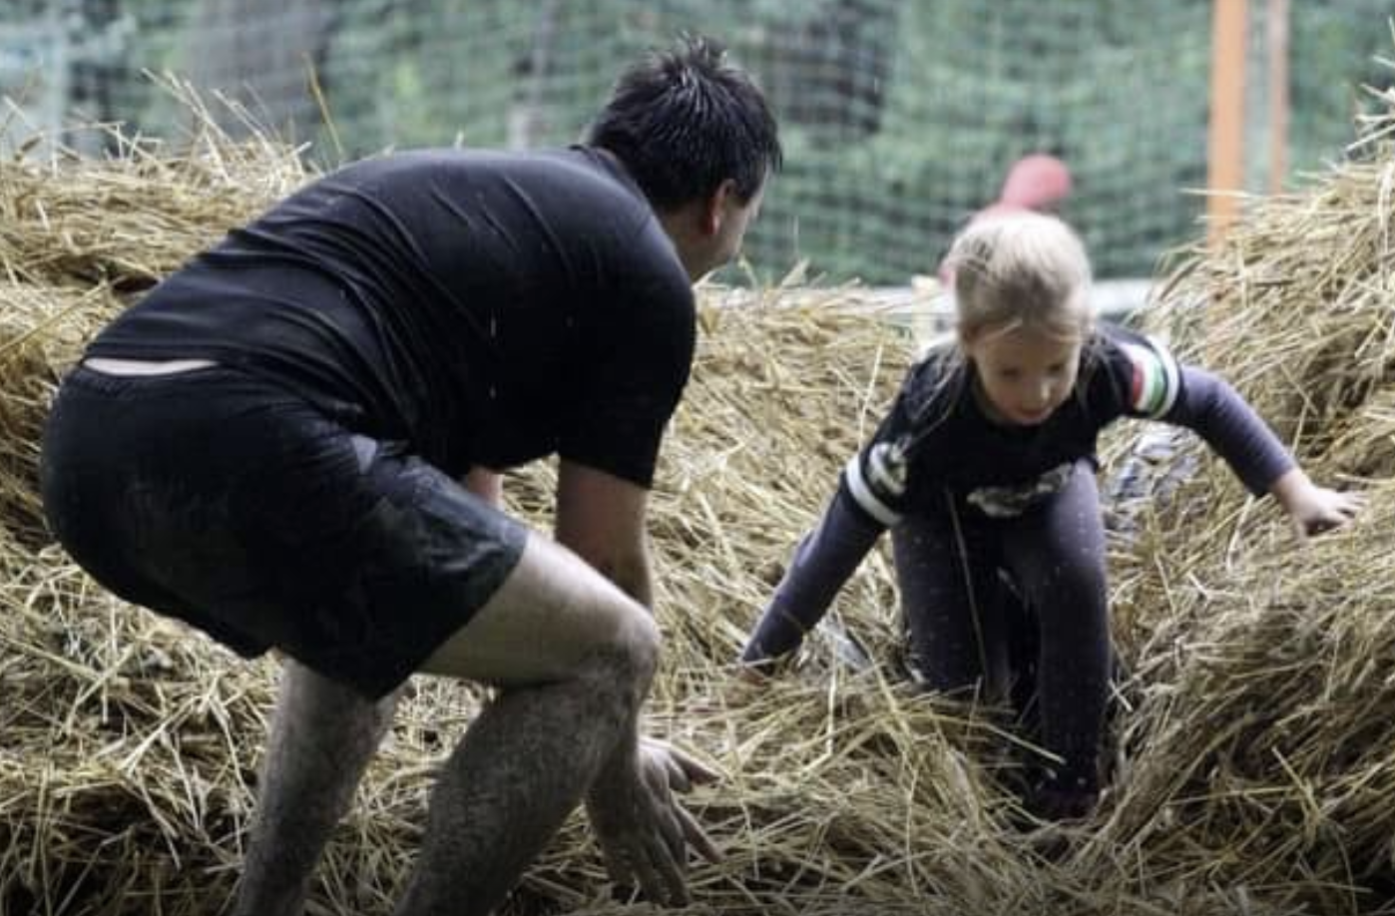
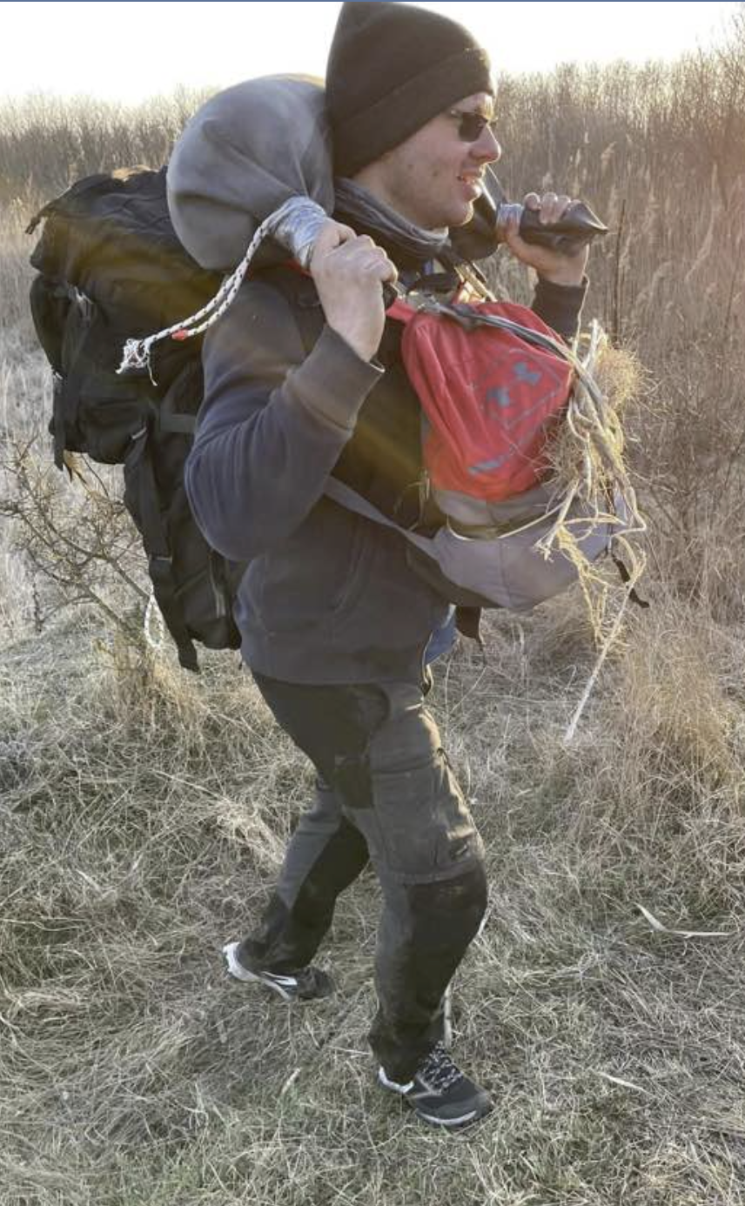

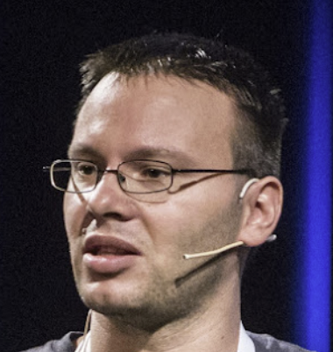
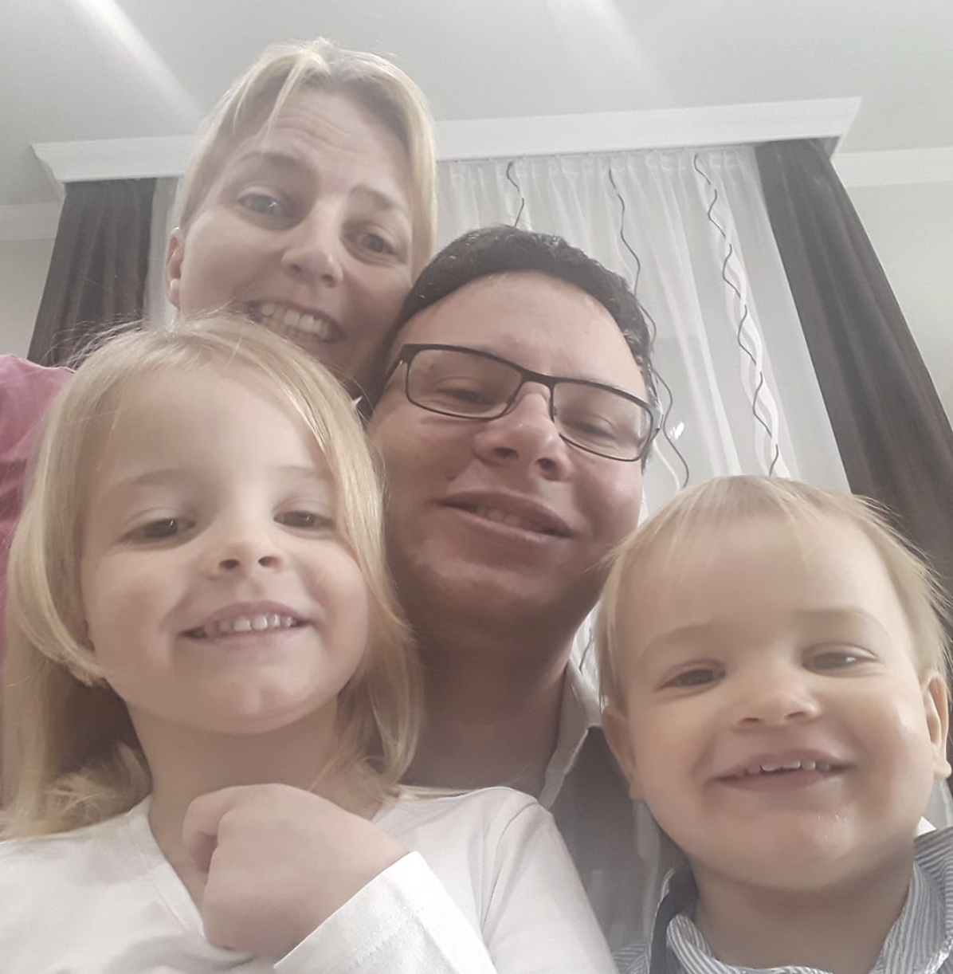

Slide 4
Back-end / Front-end / Full stack

Slide 5


Mivel foglalkozok?

Slide 6
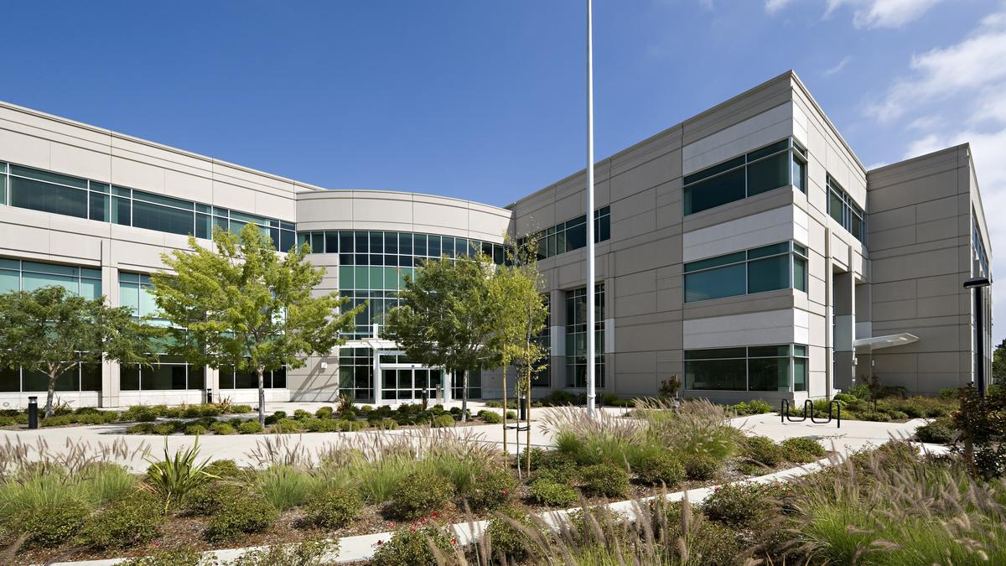

Enterprise

Slide 7
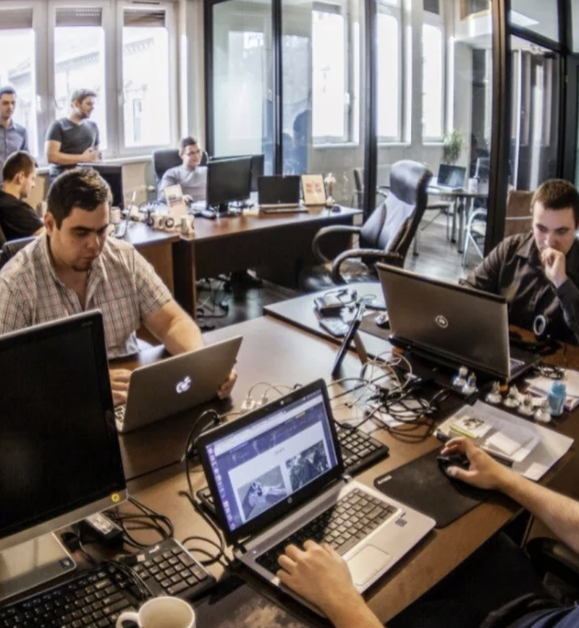
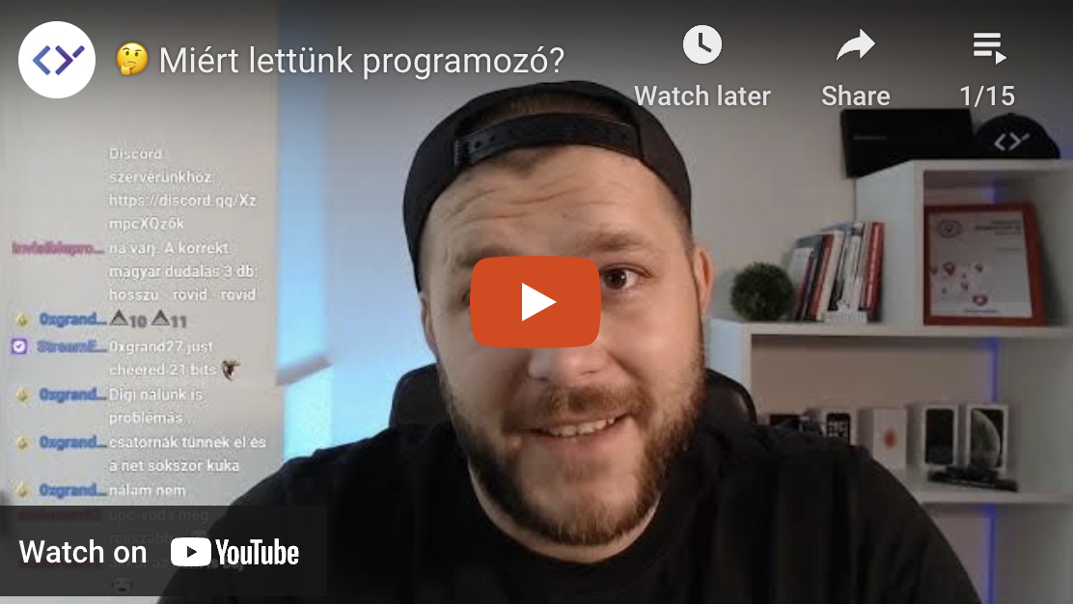
Startup

Slide 8
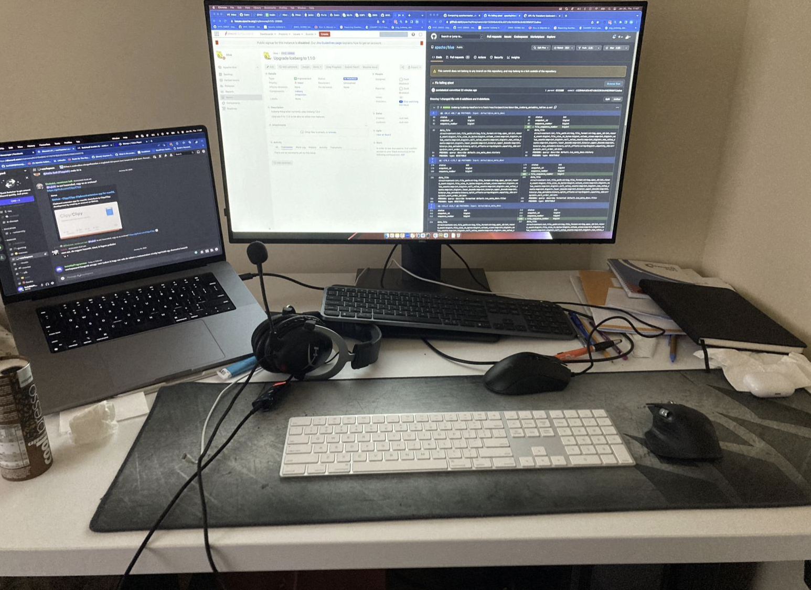
Home Office

Slide 9

Hibrid

Slide 10
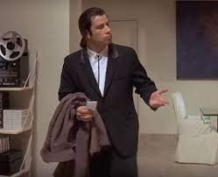
Miert vagyunk itt?

Slide 11
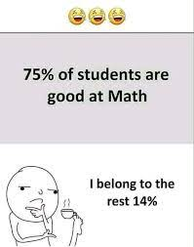
Matek

Slide 12
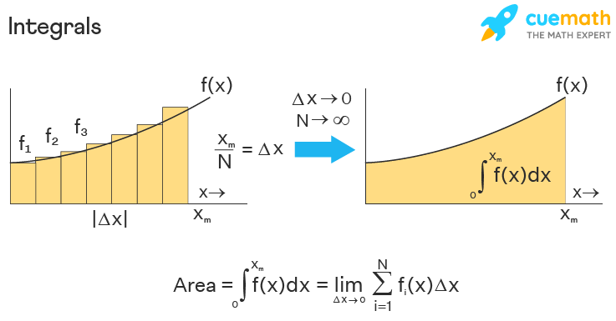
Matek

Slide 13
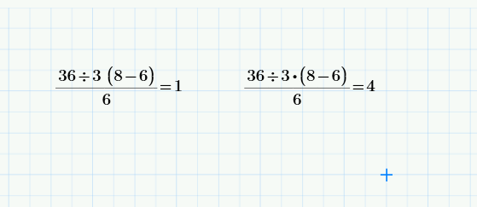

Slide 14






Programozasi nyelvek

Slide 15

Programozasi nyelvek

Slide 16
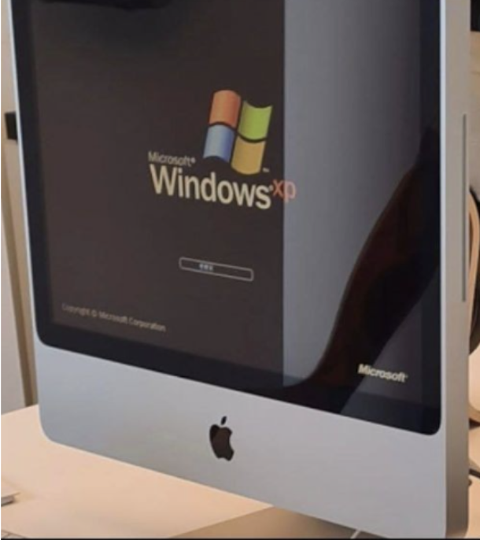

Operacios rendszer: Mac vagy Windows?

Slide 17

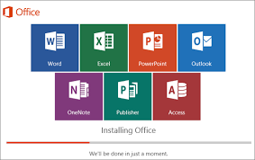

Open source vs closed source

Slide 18
Karrier utak

Slide 19
Karrier ut???? Karrier graf!
Kozepiskola, oraado tanar
Egyetem, SQL lekerdezesek
Egyetem, OTDK nevezesi rendszer
Egyetem, iktato
LogMeIn, Database Engineer
LogMeIn, Identity System
LogMeIn, JoinMe
LogMeIn, szoftver integraciok
Cloudera, PVC
Cloudera, Apache Iceberg

Slide 20
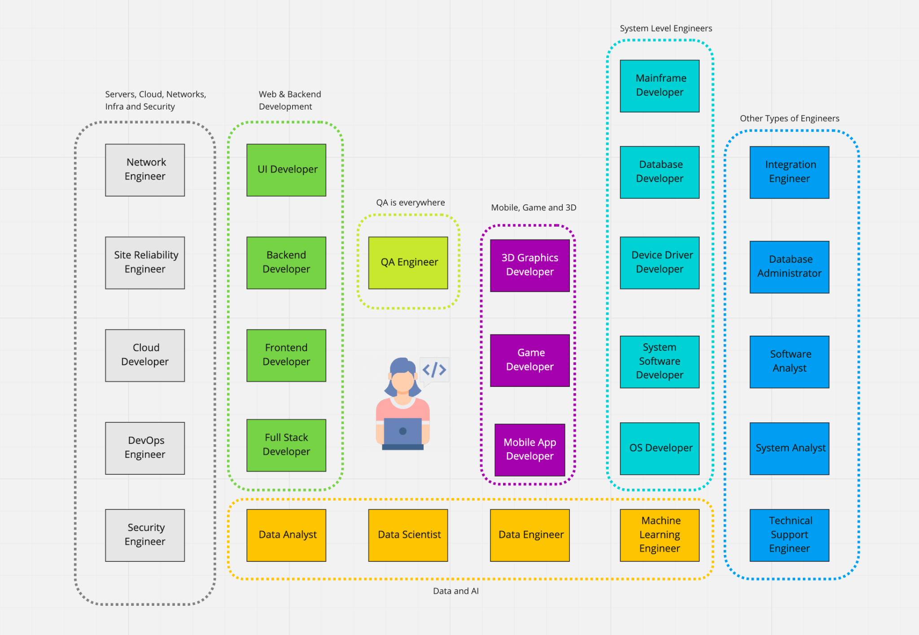

Slide 21
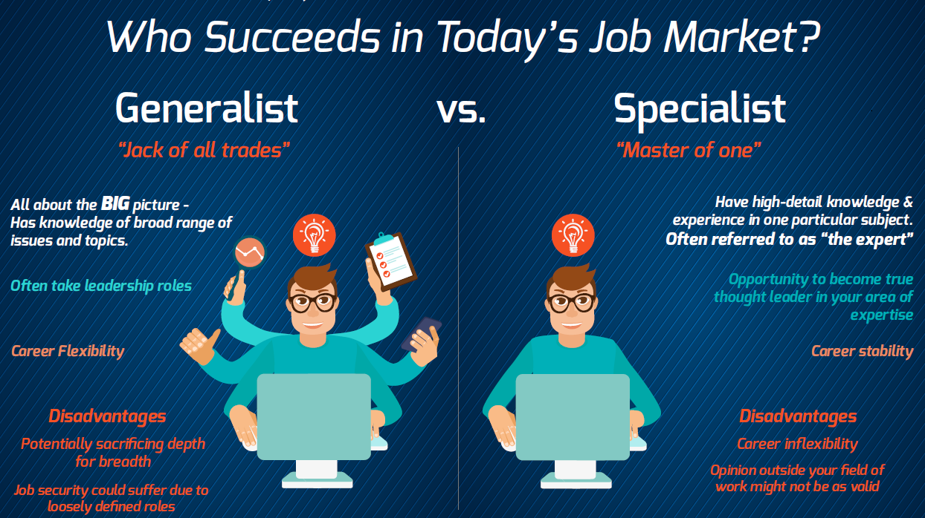

Slide 22
Szenioritas
Junior, Senior, Principal
Developer
Developer, Senior Developer
Junior, Mid level, Senior, Staff, Principal
Intern, Junior, Mid level, Senior, Staff, Senior Staff, Princial, Senior Principal

Slide 23
Szenioritas
Junior, Senior, Principal
Developer
Developer, Senior Developer
Junior, Mid level, Senior, Staff, Principal
Intern, Junior, Mid level, Senior, Staff, Senior Staff, Princial, Senior Principal

Slide 24
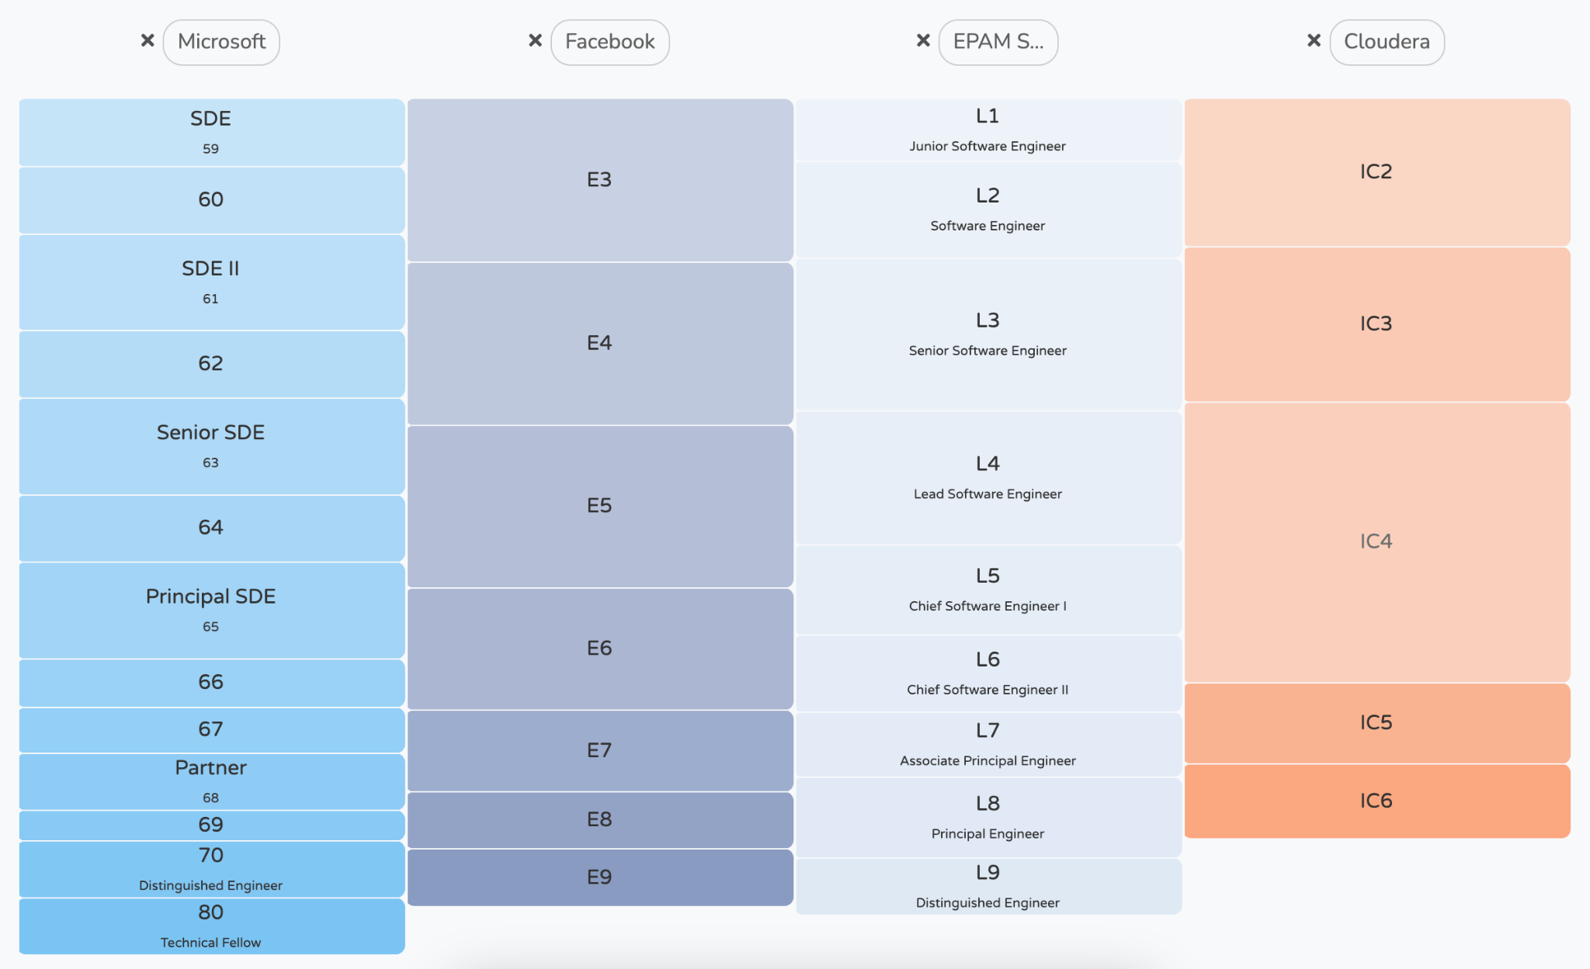

Slide 25
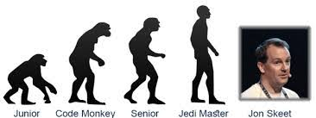
When Jon Skeet's code fails to compile the compiler apologises.

Slide 26
Hard skills
Struktpúrált programozás
Objektum-orientalt programozás
Funkcionalis programozás
Adatszerkezetek és algoritmusok
Relációs adatbázisok
NoSQL
Tiszta kód
Test Driven Development
...

Slide 27
Soft skills
Continously learning
Learn by doing
Communication, Personal types
Project management
Being a professional
How to get hired
Build reputation
Mentoring
Productivity
...

Slide 28
A legfontosabb skill

Slide 29
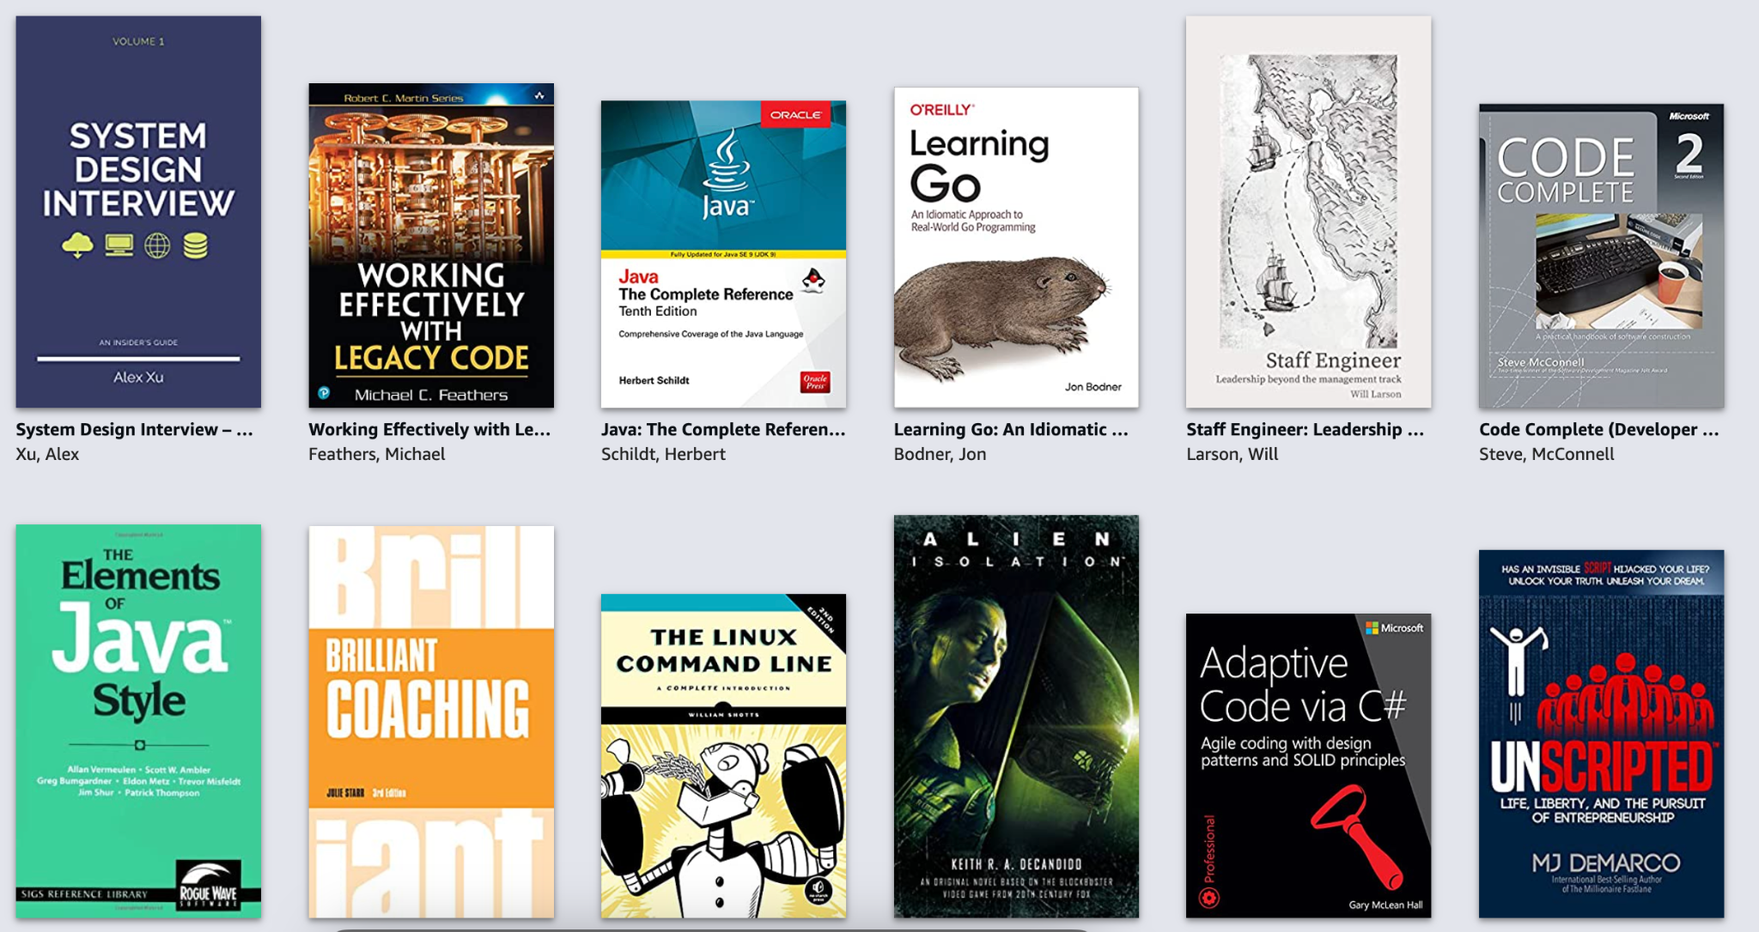
A legfontosabb skill

Slide 30
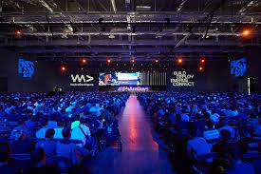
???

Slide 31
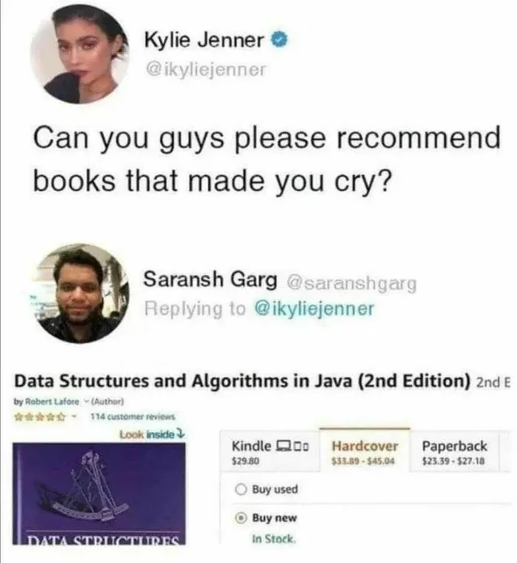
Q/A?

Slide 32
THANK YOU

